Slide 1


EDA Project : Tableau.
PREPARED BY TAIRU ADEWALE
GUIDED BY ARITRI DEBNATH
Intern NO: OGTIPTADA377

Slide 2

TOPICS
INTRODUCTION
CUSTOMER STATISTICS
SALES BY PROFIT CHART.
CUSTOMER RANKING
CONCLUSION

Slide 3

We understand how crucial it is to thoroughly and intelligently examine our customer statistics Our goal is to maximize our sales strategy by identifying important trends and opportunities to make well-informed decisions that promote growth and success on all fronts.
INTRODUCTION

Slide 4
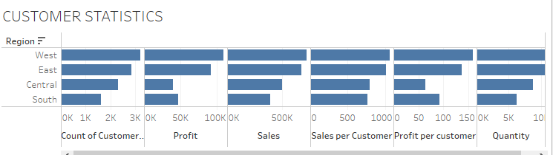
CUSTOMER STATISTICS

Slide 5

CUSTOMER Statistics CONTD
The Highest count of customers was recorded in the West region
The Lowest profits were made in the Central region
The Lowest sales were made in the southern region
The Southern region recorded the lowest Sales per Customer while the Central region made the lowest Profit per customer.

Slide 6
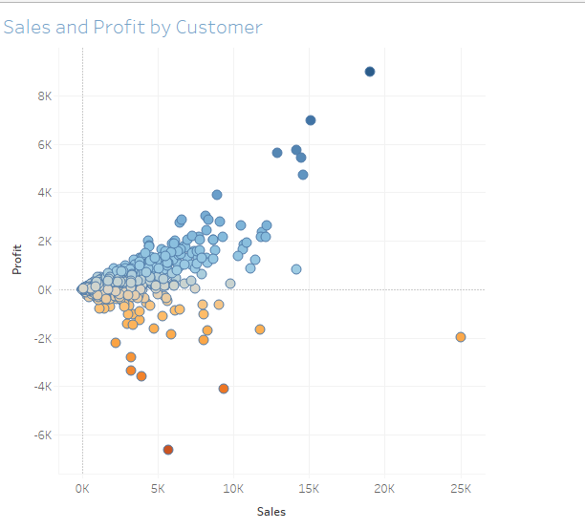
Sales by Profit Chart This scatter plot shows some varied relationship between profit and sales with some notable customers achieving a high profit and sales, while some made moderate profit and sales also some notable customers with lower profit and higher sales

Slide 7
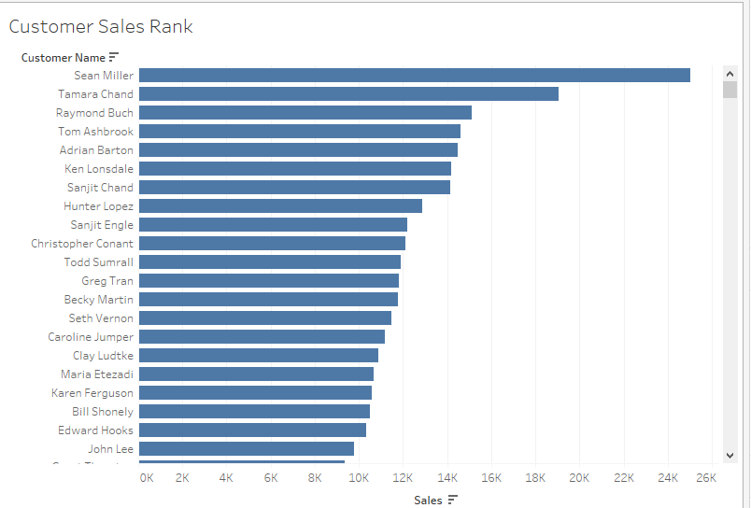
CUSTOMER RANKING
This shows the customer ranking according to their sales showing the main driver of sales.
Understanding this will help to foster customer engagement and strategies to make improved sales.

Slide 8
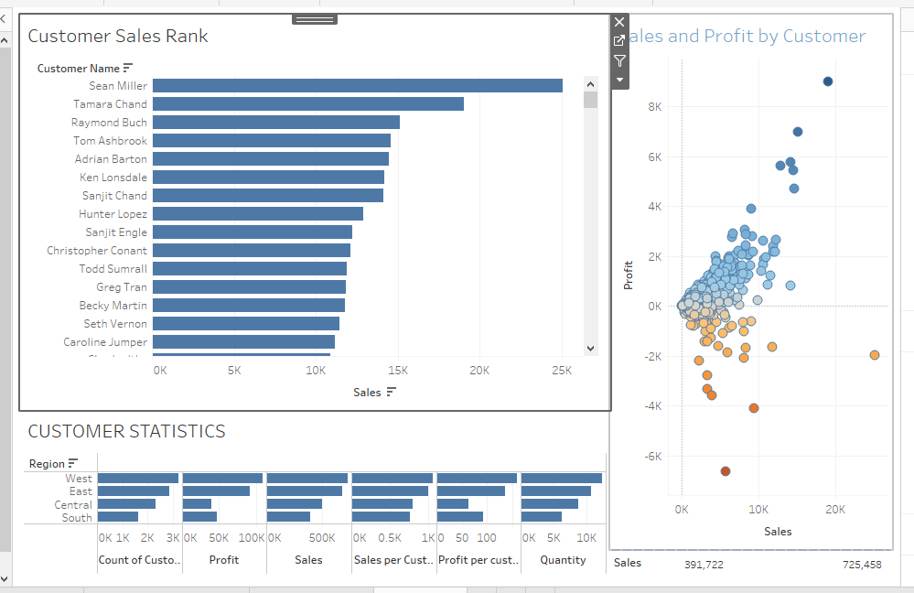
DASHBOARD
This is used to visualize the Customer statistics, customer sales rank, and sales and profit by region.

Slide 9
In conclusion, our comprehensive examination of the dashboard showcased three distinct sheets customer statistics, sales and profit by customer, and customer ranking which has yielded invaluable insights critical for our sales strategy Nonetheless, there are still issues, most notably the lowest sales and lowest earnings in the Southern and Central regions. The Sales by Profit scatter plot, which shows significant differences in profitability and sales across various customers, highlights the intricacy of our customer base even more. These insights will help us in the future as we develop focused plans to maximize performance, seize opportunities, and promote sustainable growth in all areas.
CONCLUSION

